Slide 1
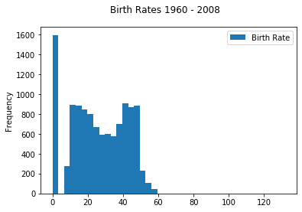
Histogram - Python

Slide 2
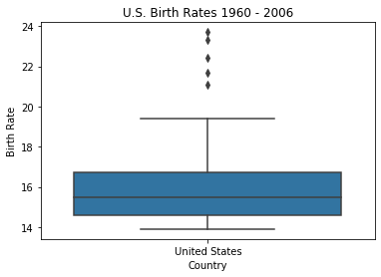
Box Plots - Python

Slide 3
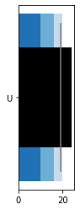
Bullet Charts - Python

Slide 4
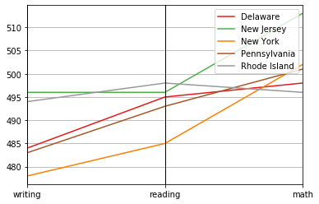
Parallel plots - Python

Slide 5
Histogram - R

Slide 6
Box Plots - R

Slide 7
Bullet Charts - R

Slide 8
Parallel plots - R

Slide 9
Histogram - Tableau

Slide 10
Box Plots - Tableau

Slide 11
Bullet Charts - Tableau

Slide 12
Parallel plots - Tableau

